Slide 1
C String Handling
Unbounded String Functions, Bounded String Functions,Common Issues

Slide 2
Strings in C
no dedicated string type
NUL terminated arrays of characters
require manual processing of strings
static (maximum) allocation
dynamic allocation
C++ standard library provides a string class
conversion between C++ strings and C strings sometimes required to use C APIs

Slide 3
Description and Problems (unbounded strings)
manipulate strings
do not take into account destination buffer size
could lead to (destination) buffer overflow
code audit: analyze all execution paths to unsafe functions
code audit: determine if such functions could be called in contexts where source is larger than destination

Slide 4
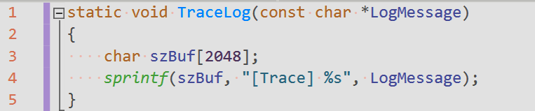
sprintf (_stprintf, _sprintf, _vsprintf, vsprintf, swprintf, vswprintf, _vswprintfA, _wsprintfW)
when destination buffer not large enough to handle input data, a buffer overflow could occur
vulnerabilities are especially due to input strings using the ``%s'' specifier

Slide 5
scanf (tscanf, wscanf, sscanf, fscanf, fwscanf, _snscanf, _snwscanf)

Slide 6
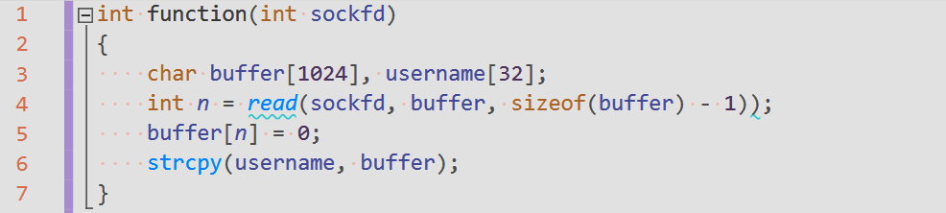
strcpy (_tcscpy, lstrcpyA, wcscpy, _mbscpy)
copy source in destination until encounters NUL character
if destination buffer is smaller than the source one, a buffer overflow could occur

Slide 7
strcat (_tcscat, wcscat, _mbscat)
similar problems like with strcpy

Slide 8
Description and Problems (bounded strings)
designed to give programmers a safer alternative to the unbounded functions
include an argument to specify the maximum length
vulnerabilities occur due to misuse of the length argument
Careless
erroneous input
length miscalculation
arithmetic boundary conditions
converted data types

Slide 9
snprintf (_sntprintf, _snprintf, _vsnprintf, vsnprintf, _snwprintf, vsnwprintf)
bounded replacement of sprint
works slightly different on Windows and UNIX, when limit is reached
Windows: returns -1 and there is no NUL termination
UNIX: there is NUL termination and returns the number of bytes that would have been written had there been enough space

Slide 10
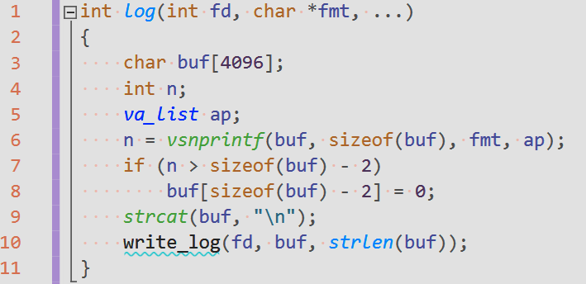
snprintf (_sntprintf, _snprintf, _vsnprintf, vsnprintf, _snwprintf, vsnwprintf)
example of vulnerable code (UNIX behavior assumed in a Windows application)

Slide 11
strncpy (_tcsncpy, _csncpy, wcscpyn, _mbsncpy)
is the secure (bounded) alternative to strcpy
it is given the maximum number of bytes to copy in destination
does not guarantee NUL termination of destination string in case source is larger than maximum allowed
using a non NUL-terminated string (a possible result of strncpy) could be a vulnerability

Slide 12
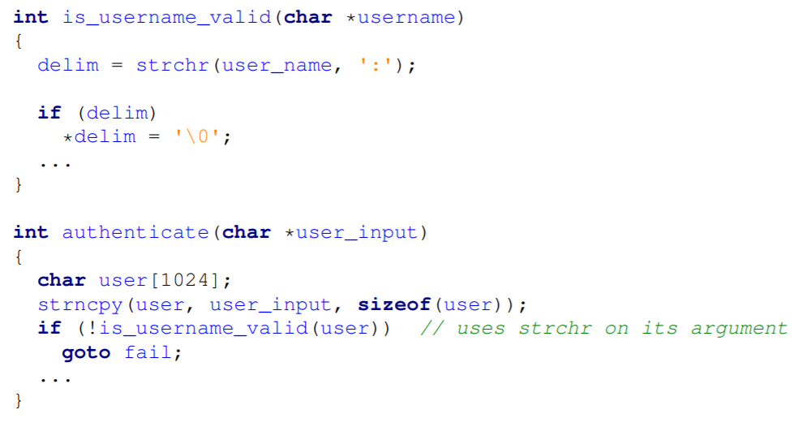
strncpy (_tcsncpy, _csncpy, wcscpyn, _mbsncpy)

Slide 13
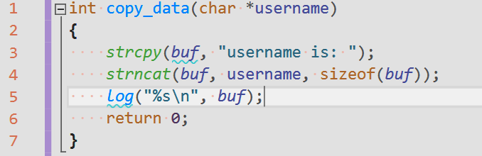
strncat (_tcsncat, wcsncat, _mbsncat)
the safe alternative to strcat
misunderstood aspect: the size parameter indicates the space remained in buffer, not its total size
example: vulnerable because specify the total buf’s size

Slide 14
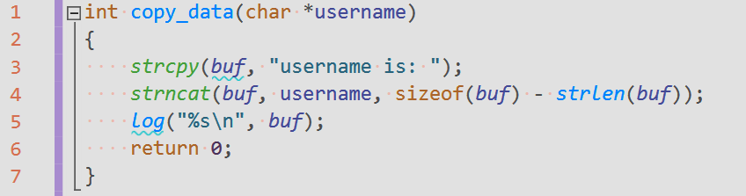
strncat (cont.)
the size parameter must also account for the trailing NUL byte
example: off-by-one vulnerable as not taking into account the NUL byte
when supplying the size parameter as a formula, possible integer overflow/underflow must be considered

Slide 15
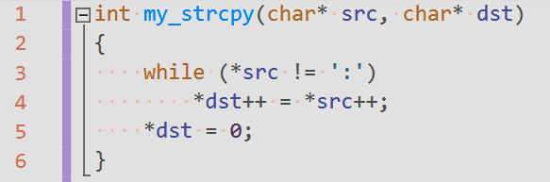
Common Issues - Unbounded Copies
no checking on the bound of destination buffers
a user implementation similar to strcpy vulnerability

Slide 16
Common Issues - Character Expansion
occurs when programs encode special characters, resulting in a longer string than the original
common to metacharacter handling and raw data formatting to make it human readable
example: vulnerable as for each non-printable character in src writes two bytes in dst
TODO: Test and resolve issues with below string manipulation routine

Slide 17
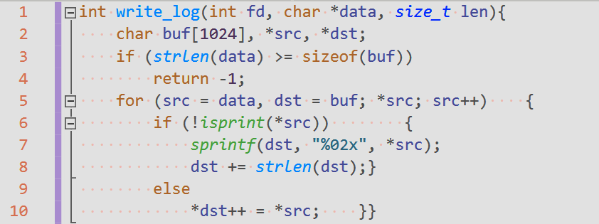
Common Issues - Character Expansion (contd)

Slide 18

Common Issues - Incrementing Pointers Incorrectly
in cases pointers are incremented over the bounds of strings they operate on, like
NUL-termination does not exists (as a result of strncpy)
NUL-termination is skipped by mistake
example: vulnerable because not check for NUL-termination

Slide 19
Metadata
metadata = information that describes or augments the main data
displaying format
processing instructions
memory storage details
in-band representation embeds metadata in data itself normally done by using special characters (metacharacters)
the NUL termination in C strings, ’/’ in a file path, ’.’ in a host name, ’@’ in an email address etc.
advantages: more compact and human readable
disadvantages: security problems generated by overlapping trust domains (i.e. data and metadata placed in the same trusted domain)
out-of-band representation keeps metadata separate from data and associate them
string types in programming languages like C++, Java etc.
security problems occur if input data containing metacharacters is not correctly sanitized

Slide 20
Metadata - Embedded Delimiters
vulnerabilities are generated if the attacker can introduce (additional) delimiter characters and input format is not checked ⇒ injected delimiter attacks if input is not sanitized
Example: let us consider a file format like “username:password”, with ’:’ and ’\n’ as delimiters if a “john” user could provide a password like “my_pass\nattacker:attacker_pass\n” the user-password file would look like
john:my_pass
attacker:attacker_pass
Code review:
identify code dealing with metacharacter strings
identify the specially handled delimiters
identify and check any filtering performed on input
⇒ any unfiltered delimiter could lead to a vulnerability

